Slide 1
CSCI 561 Foundation of Artificial Intelligence
Professor Wei-Min Shen
Session 22: Utility-Reward-Policy-POMDP

Slide 2
Utility, Policy, Iterations
Probabilistic Decision Making
Actions, Transactions, and Sensor Models
Utility Theory
Decision Networks
Markov Decision Processes (MDP)
Partially Observable MDP (POMDP)
Value Iteration
Policy Iteration

Slide 3
Recall Rational Agents
How to design this?
Sensors
percepts
Environment
?
Agent
actions
Effectors

Slide 4
The Key Ideas
Model the environment by States, Actions, Percepts, and Transactions
States have Utility U(s)
Maximum Expected Utility
EU(a|e) = Σ P(s|a,e) U(s)
Markov Decision Process (MDP): State, Action, Transition P(s’|s,a), Reward, s➔r, or (s,a)➔r
Solutions are represented as Policy: s➔a.
Total discounted expected reward (Bellman):
Equation 17.5 or in ALFE page 167.
Partially Observed MDP (POMDP)
States cannot be completely observed
Need a Sensor Model P(z|s)
Objective: finding the optimal policy based on utilities

Slide 5
Examples of Reasoning with Uncertainty
Speech Recognition
“Listening is not always equal to hearing” ☺
Traveling through rooms with colored walls
“Seeing does not always tell where you are” ☺
Room-1
Room-2
Room-3
a₀
a₁
a₂
a₃
Wall-color
Wall-color
Wall-color

Slide 6
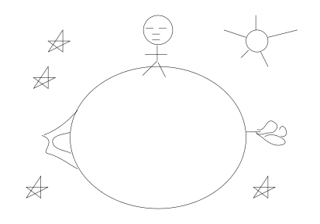
States, Actions and Sensors The Little Prince’s Planet Example
Percepts: {rose, volcano, nothing}
Actions: {forward, backward, turn-around}
States: {north, south, east, west}

Slide 7
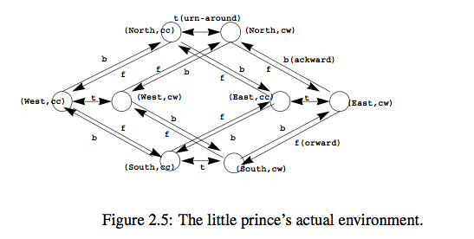
The Little Prince Planet Environment
See Nothing
See Volcano
See Rose
See Nothing

Slide 8
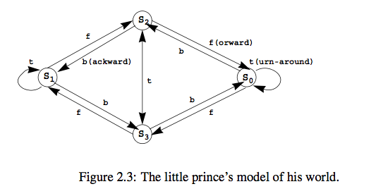
A Model for Little Prince’s Planet
See Nothing
See Rose
See Volcano
See Nothing
His internal action model only needs 4 states! (why?)

Slide 9
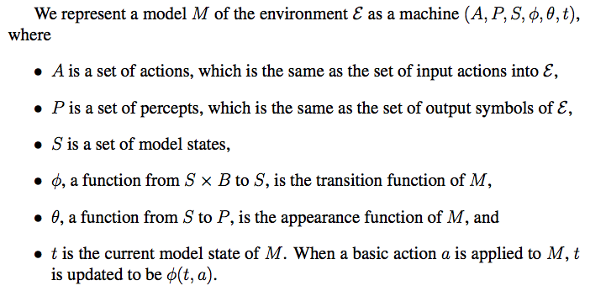
The State/Action/Sensor Model

Slide 10
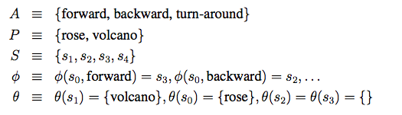
Little Prince’s Deterministic Model
Are the actions deterministic?
Are the sensors deterministic?
Is there any hidden states in this example?

Slide 11
Two Big Uncertainties
“Seeing may not be believing”
States and observations are not 1-1 mapping
One state may be seen in many different ways
The same observation may be seen in many different states
E.g., When the prince sees nothing, where is he? Facing which way?
Can you made the little prince’s sensors non-deterministically?
“Action may not produce the same result”
Actions do not always take you to the same states
E.g., the little prince’s planet may have “planet-quakes” ☺
Transitions between states by actions may be nondeterministic
Can you made the little prince’s actions non-deterministically?

Slide 12
Certainty vs Uncertainty
The certain way
s1
a1
s2
The uncertain way
S1 is not always blue
S2 is not always red
s1
a1
s2
a1
a1
s3
“a1” from S1
does not always go to S2
s3

Slide 13
Uncertainty in Sensor & Actions
?
S19
?
State
?
Observations
?
?
?
?
?
Solution: let’s use probabilities
Action Model (for states and actions)
Use Probabilistic Transitions P( NextState | CurrentState, Action)
Sensor Model (for states and observations)
P( Observation | State )

Slide 14
Hidden Markov Model (with actions)
z2
z1
z3
z1
s23
a1
s94
a1
1. Actions
2. Percepts (observations)
3. States
4. Appearance: states → observations
5. Transitions: (states, actions) → states
6. Current State
a1
s77

Slide 15
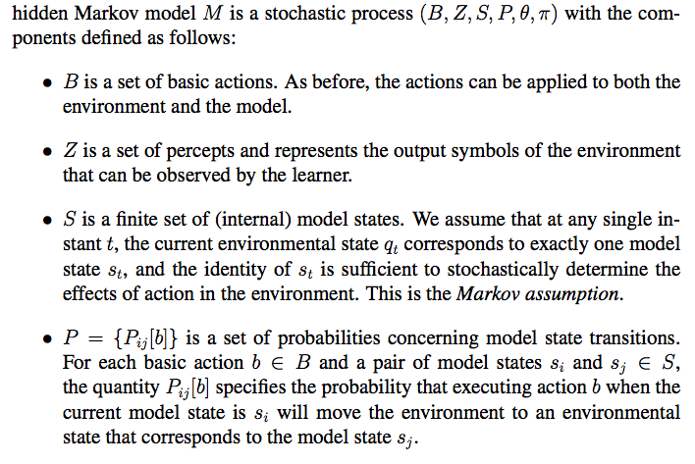
Hidden Markov Model (1/2)
Action Model

Slide 16
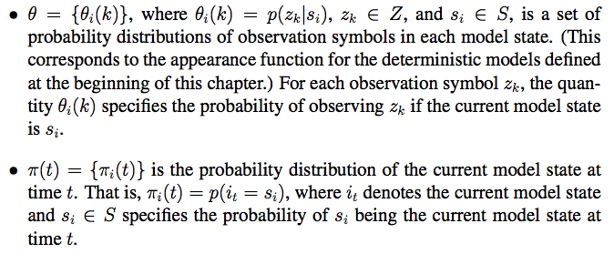
Hidden Markov Model (2/2)
Sensor Model
This is also called “localization”

Slide 17
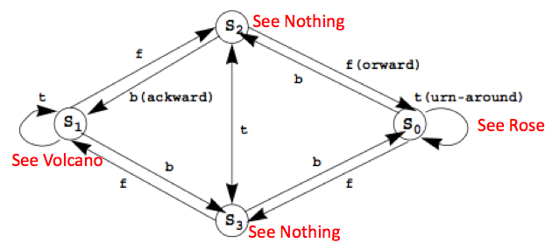
The HMM for Little Prince’s Planet (with uncertain actions and sensors)
{P(s3|s0,f)=.51, P(s2|s1,b)=.32, P(s4|s3,t)=.89, …}
{P(rose|s0)=.76, P(volcano|s1)=.83, P(nothing|s3)=.42, …}

Slide 18
Experience and State Sequence
E_{1:T} is an experience is a sequence of
{observe₁, act₁, observe₂, act₂, …., act_{T-1}, observe_{T}}
E_{1:T} = {o₁, a₁, o₂, a₂, o₃, …, o_{T-1}, a_{T-1}, o_{T}}
X_{1:T} is a sequence of states that may be hidden but correspond to the experience
X_{1:T} = {X₁, X₂, X₃, …, X_{T-1}, X_{T}}

Slide 19
Little Prince Example
From an “experience” (time 1 through t)
Infer the most likely “sequence of states”
{rose}, forward, {.}, …, turn, …, {rose}, bwd, {volcano}
S1 S2 S3 S4
S1 S2 S3 S4
S1 S2 S3 S4
S1 S2 S3 S4
……
Find the “best sequence of (hidden) states” that support the experience!

Slide 20
Action and Sensor Models (review)
z2
z1
z3
z1
s23
a1
s94
a1
1. Actions
2. Percepts (observations)
3. States
4. Appearance: states → observations
5. Transitions: (states, actions) → states
6. Current State
a1
s77
What about the goals?

Slide 21
Utility or Value of States Utility ⬄ Goal Information
z2
z1
z3
z1
s23
a1
s94
U(s23)=0.4
1. Actions
2. Percepts (observations)
3. States
4. Appearance: states → observations
5. Transitions: (states, actions) → states
6. Current State
7. Rewards: R(s) or R(s,a) (related to the goals, given to us)
(8) Value/Utility of States: U(s) (how good for the goals, not given)
a1
U(s94)=0.2
a1
s77
U(s77)=0.4

Slide 22
Reward and Action Example
-0.04 | -0.04 | -0.04 | +1
-0.04 |  | -0.04 | -1
-0.04 (start) | -0.04 | -0.04 | -0.04
0.1
Intended
0.8
0.1
Rewards (not utility) as shown:
Two terminal states: -1, +1 (goal)
-0.04 for all nonterminal states
Actions: ←, →, ^, v,
outcome probability:
0.8 for intended,
0.2 sideways

Slide 23
Utility/Values Example
? | ? | ? | +1
? | ? | ? | -1
? | ? | ? | ?
0.1
Intended
0.8
0.1
State Values or Utilities:
Must be computed by the agent

Slide 24
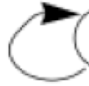
Little Prince Example (may add Rewards)
(action) Transition Probabilities Φ (Fwd, Back, Turn)
(sensor) Appearance Probabilities θ
Initial State Probabilities π
F | S0 | S1 | S2 | S3
S0 | 0.1 | 0.1 | 0.1 | 0.7
S1 | 0.1 | 0.1 | 0.7 | 0.1
S2 | 0.7 | 0.1 | 0.1 | 0.1
S3 | 0.1 | 0.7 | 0.1 | 0.1
B | S0 | S1 | S2 | S3
S0 | 0.1 | 0.1 | 0.7 | 0.1
S1 | 0.1 | 0.1 | 0.1 | 0.7
S2 | 0.1 | 0.7 | 0.1 | 0.1
S3 | 0.7 | 0.1 | 0.1 | 0.1
T | S0 | S1 | S2 | S3
S0 | 0.7 | 0.1 | 0.1 | 0.1
S1 | 0.1 | 0.7 | 0.1 | 0.1
S2 | 0.1 | 0.1 | 0.1 | 0.7
S3 | 0.1 | 0.1 | 0.7 | 0.1
θ | Rose | Volcano | Nothing
S0 | 0.8 | 0.1 | 0.1
S1 | 0.1 | 0.8 | 0.1
S2 | 0.1 | 0.1 | 0.8
S3 | 0.1 | 0.1 | 0.8
π | S0 | S1 | S2 | S3
 | .25 | .25 | .25 | .25
You may add rewards to states (e.g., prefer to see rose)

Slide 25
Little Prince in Action (POMDP)
E_{1:T}
{rose}, fward, {none}, …, turn, {rose}, back, {volcano}
time
S1 S2 S3 S4
S1 S2 S3 S4
S1 S2 S3 S4
S1 S2 S3 S4
Partially
Observable
……
Given: “experience” E_{1:T} (time 1 through T)
Definitions:
State S and actions A (Forward, Back, Turn)
(Action model) Transition Probabilities Φ
(Sensor model) Appearance Probabilities θ (rose, volcano, none)
(localization) Initial/current State Probabilities π
Partially observable: for you only see the percepts, not the states

Slide 26
State Utility and Decision on Actions
Combine the following together
Partially observable action/perception model
E.g., Little Prince Example
State values from goals
E.g., see Dynamic Programming example (next slide)
Policy (choose action from state values)
In order to gain as much as rewards as you can

Slide 27
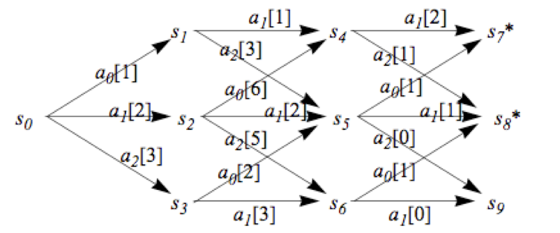
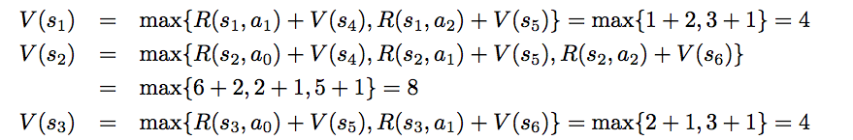


Compute State Values by Dynamic Programming (review, from ALFE 6.1.1)
Backward recursion: compute the future cost by back from the goal* stage by stage
Rewards are given
a_{i}[R] = R(s,a_{i}) from
an action a_{i} on a state s
Backward recursion equation:

Slide 28
Markov Decision Process (MDP)
A MDP consists of
State S and actions A
Initial State s₀ Probability Distribution π
Transition Model Φ(s’|s,a)
Sensor Model θ(z|s)
A reward function R(s)
Note: A typical MDP has no sensor model

Slide 29
Maximum Expected Utility (MEU) and Rational Agents
Every state has a utility value U(s)
The expected utility of an action given the current evidence or observation e, is the average utility value of the outcomes, weighted by the probability that the outcome occurs:
The principle of maximum expected utility (MEU) is that a rational agent should choose the action that maximizes its expected utility:
z2
z1
s2
a1
s9
U(s2)=0.4
a1
U(s9)=0.2
a1
s7
U(s7)=0.4

Slide 30
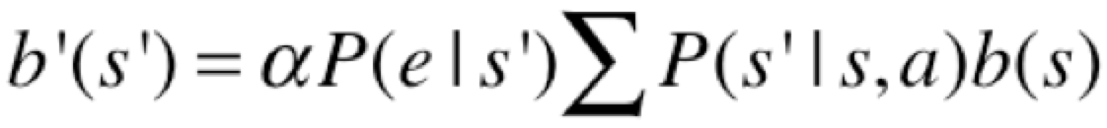
POMDP, Transitions, Belief States
A POMDP consists of
A set of states S (with an initial state s₀)
A set of Actions(s) of actions in each state
A transition model P(s’|s,a), or T(s,a,s’)
A reward function R(s)
A sensor model P(e|s) ⬅
A belief of what the current state is b(s) ⬅
Belief States (what is my current state?):
If b(s) was the previous belief state, and the robot does action “a” and then perceives a new evidence “e”, then the new belief state: where α is a normalization constant making the belief states sum to 1

Slide 31
Goals, Rewards, Utilities, Policies
Goals
Given to the agent from the problem statements
Rewards
Given to the agent, designed based on the goals
Utility or Values for states
Computed by the agent, based on the rewards
Policies
Computed or learned by the agent
Used by the agent to select its actions
The better a policy, the more rewards it collects

Slide 32
Compute Utilities from Rewards over Time
Future Rewards
Add them as they are
Discount the far-away ones
The expected future utility U^{π}(s) obtained by executing a policy π starting from s
The Optimal Policy

Slide 33
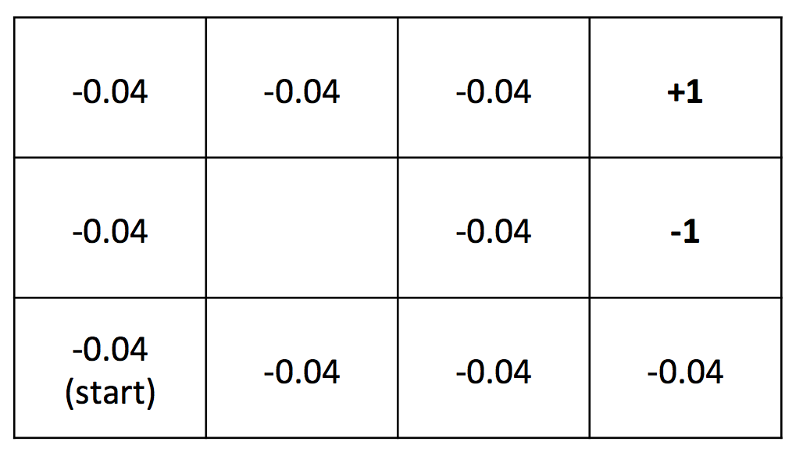
Compute Utilities (example)
0.812 | 0.868 | 0.918 | +1
0.762 |  | 0.660 | -1
0.705 | 0.655 | 0.611 | 0.388
Rewards (given)
Utilities (computed)
Given the rewards in all nonterminal state are R(s) = - 0.04,
Compute utilities using a future discount γ = 1
(we will see how these utilities are computed)

Slide 34
State Utility Value Iteration (improving U(s) every step)
U(s): the expected sum of maximum rewards achievable starting from a particular state s
Bellman equations:
Many equations must be solved simultaneously
Bellman iteration:
Converge to U*(s) step by step

Slide 35
Bell Iteration Example
The Initial Utilities
Reward R(s)
0.0 | 0.0 | 0.0 | 0.0
0.0 |  | 0.0 | 0.0
0.0 | 0.0 | 0.0 | 0.0
-0.04 | -0.04 | -0.04 | +1
-0.04 |  | -0.04 | -1
-0.04 | -0.04 | -0.04 | -0.04
Transaction probability T(s, a, s’) = 0.8 for intended, 0.2 for sideways
Discount Gamma = 1.0
0.812 | 0.868 | 0.918 | +1
0.762 |  | 0.660 | -1
0.705 | 0.655 | 0.611 | 0.388
The Finial Utilities

Slide 36
Value Iteration for POMDP
In MDP value iteration, when sensors are certain, we know the next state s’
In POMDP, where sensors are uncertain, we must average over all possible evidences for the next state s’ (see the last term below):

Slide 37
Policy and Optimal Policy
A solution of (PO)MDP can be represented as
A Policy π(s)=a
Each execution of policy from s₀ may yield a different history or path
An optimal policy π*(s) is a policy that yields the highest expected utility

Slide 38
Policy based on Known Utilities
0.812 | 0.868 | 0.918 | +1
0.762 |  | 0.660 | -1
0.705 | 0.655 | 0.611 | 0.388
Suppose we know the utilities of the states as above,
What path would an optimal policy would choose?
Rewards → Utilities/Values → Policies

Slide 39
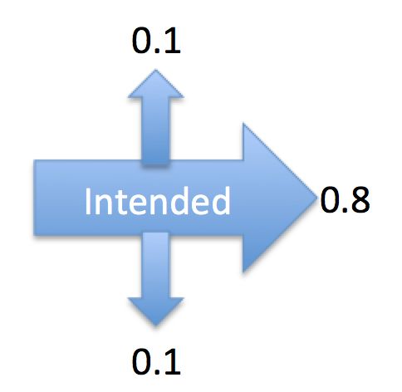
Optimal Policy Examples Depending on Reward distribution R(s)
When the rewards for the nonterminal states are evenly distributed (e.g., -0.04), then the path chosen will depend on the probabilities of the transition model
→ | → | → | +1
^ |  | ^ | -1
^ | ← | ← | ←
3
Nonterminal R(s)= - 0.04
2
1
1
2
3
4
Caution: because the nondeterministic actions, from state (3,2) or (4,1),
you may “accidentally” go to (4,2). So there is a “risk” in this policy.

Slide 40
Optimal Policy Examples Depending on Reward distribution R(s)
→ | → | → | +1
^ |  | → | -1
→ | → | → | ^
→ | → | → | +1
^ |  | ^ | -1
^ | → | ^ | ←
Nonterminal rewards R(s)=-0.04
suicide
risky
→ | → | → | +1
^ |  | ^ | -1
^ | ← | ← | ←
R(s)<-1.6284
(life is painful, death is good)
-0.4278 < R(s)<-0.0850
(life is OK, willing to risk)
→ | → | → | +1
^ |  | ← | -1
^ | ← | ← | ←
❖ | ❖ | ← | +1
❖ |  | ← | -1
❖ | ❖ | ❖ | V
end nicely
don’t end
?
Why not go up?
no risk
no risk
risky
no risk
Hint: Consider the nature of actions, deterministic or not
Go up is “risky”
-0.0221<R(s)<0
(life is good, minimize risks, willing to end nicely)
R(s)>0
(life is rewarding,
I don’t want to end it)

Slide 41
Optimal Policy
You can compute it once after U*(s) is known
Or, you can compute it incrementally every iteration when U_{i}(s) is updated
This is called “Policy Iteration” (see the next slide)

Slide 42
Policy Iteration (improving π(s) every step)
Start with a randomly chosen initial policy π₀
Iterate until no change in utilities:
Policy evaluation: given a policy π_{i}, calculate the utility U_{i}(s) of every state s using policy π_{i} by solving the system of equations:
Policy improvement: calculate the new policy π_{i+1} using one‐step look‐ahead based on U_{i}(s):

Slide 43
Policy Iteration Comments
Each step of policy iteration is guaranteed to strictly improve the policy at some state when improvement is possible
Converge to the optimal policy
Gives the exact value of the optimal policy

Slide 44
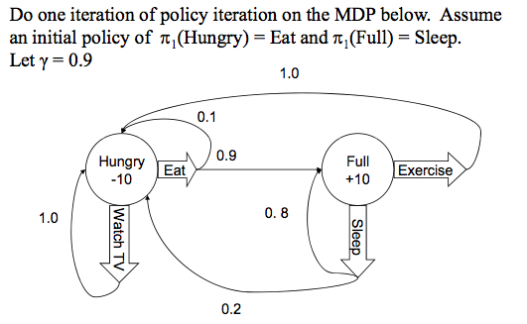
Policy Iteration Example

Slide 45
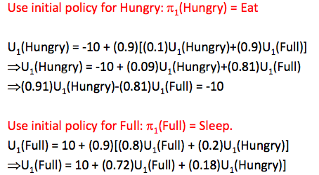
Policy Iteration Example

Slide 46
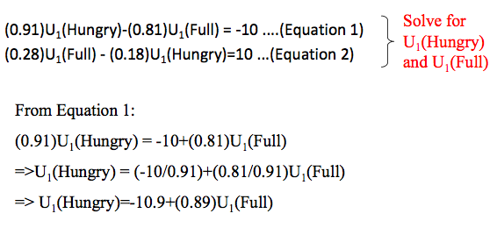
Policy Iteration Example

Slide 47
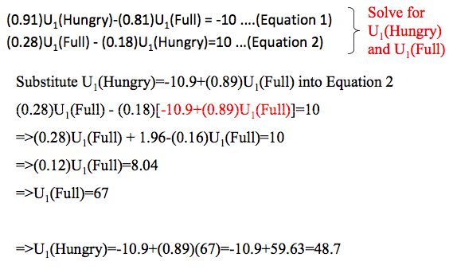
Policy Iteration Example

Slide 48
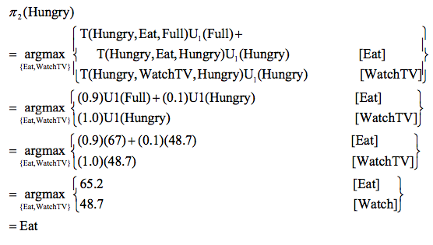
Policy Iteration Example

Slide 49
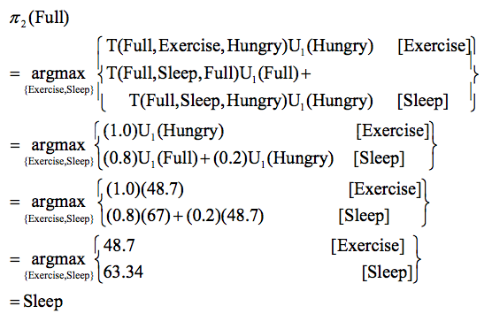
Policy Iteration Example

Slide 50
Policy Iteration Example
The new policy π₂ after an iteration from π₁
π₂(Hungry)→Eat
π₂(Full)→Sleep

Slide 51
Summary
POMDP is very (the most) general model
Deal with uncertainty by
action models and sensor models
Incorporate goals → rewards → utilities → policy
Solve a problem by following a good policy
One policy for one problem
Utilities and policies can be computed from rewards
Systematically (Bellman equations)
Iteratively (Bellman’s iteration algorithm)

